Slide 1
I
Enterprise Financial Data Platform
By :
Avirup Das | 26MML1005
T Alagupandi | 26MML1013
Y Aditya Venkat | 26MML1025

Slide 2
Enterprise Financial Data Platform
I
Building a Unified Insurance Data Platform for Policy, Claims & Risk Analytics
Covered Sprints:
Sprint 0 — Project Initiation & Architecture
Sprint 1 — Data Discovery & Ingestion
Sprint 2 — Data Profiling & Data Warehouse
Sprint 3 — Visual Analytics & Governance
This project focuses on building an enterprise-level financial data platform. The objective is to integrate financial and master data collected from multiple independent enterprise systems and create a unified, curated foundation for financial reporting and analysis.

Slide 3
Objectives & Scope
Unify Core Data : Integrates disparate systems—policy, claims, CRM, and underwriting—into a single PostgreSQL platform.
Ensure Governance : Implements built-in metadata, audit logs, and data lineage to track and secure data.
Power Analytics & Compliance : Standardizes insurance data to support risk modeling, executive dashboards, and regulatory reporting.
Collaborative Foundations : Establishes version control using Git/GitHub and enterprise-level documentation.

Slide 4
Technology Stack
Component | Technology | Purpose
ETL | Pentaho Data Integration | Data ingestion and ETL transformations
Database | PostgreSQL | Staging and enterprise data storage
Programming | Python / Pandas | Data processing and profiling
Version Control | Git / GitHub | Collaboration and version control
Reporting | Power BI | Business dashboards and reporting
Documentation | Markdown / MS Word | Technical documentation
Methodology | Agile Scrum | Sprint-based project development

Slide 5
Sprint Roadmap
Sprint 0 — Project Initiation & Architecture
Understand business requirements
Identify stakeholders
Identify enterprise data sources
Define project scope
Design solution architecture
Set up the Git repository
Sprint 1 — Data Discovery & Ingestion
Analyze source systems across finance domains
Prepare the Data Dictionary
Develop Pentaho ingestion pipelines
Load raw data into PostgreSQL staging tables
Implement logging and exception handling

Slide 6
Sprint Roadmap
Sprint 2 — Data Profiling and Data Warehouse
Profile the ten staging tables using Python
Assess data quality: duplicates, missing entries, inconsistent balances and master data issues
Clean and standardize financial records
Design the star schema and create fact and dimension tables
Populate the warehouse tables

Slide 7
Sprint Roadmap
Sprint 3 — Visual Analytics & Governance
Connect Power BI to the PostgreSQL star schema
Build the EFDP dashboard: KPIs, trends and breakdowns by G/L account and company code
Add interactive filtering with a company code slicer
Review dashboard totals against the staging data
Document governance and traceability controls

Slide 8
Sprint 0: Business Analysis
Objective: Understand the enterprise finance ecosystem and design the Enterprise Financial Data Platform before development begins.
Key Activities
Study enterprise finance processes and the broader ERP landscape
Identify business stakeholders and financial reporting requirements
Prepare the Business Requirements Document (BRD)
Identify financial and master data sources across the organization
Define project scope, objectives and success criteria
Design the high-level Financial Data Platform architecture

Slide 9
Sprint 0: Project Setup & Deliverables
Project Setup
Create Git repository and enterprise repository structure
Prepare the Sprint Backlog
Design the Solution Architecture (layered Bronze/Silver/Gold model)
Prepare the Project Charter
Sprint 0 Deliverables
Business Requirements Document (BRD)
Solution Architecture
Git Repository
Sprint Backlog
Project Charter

Slide 10
Sprint 1: Data Discovery & Ingestion
Objective : Build the Financial Data Landing Zone by integrating heterogeneous financial and master data collected from multiple enterprise systems, and loading raw data into PostgreSQL staging.
Key Activities
Prepare the Data Dictionary with field descriptions, data types and examples
Validate business keys and relationships across source systems
Build Pentaho transformations for the supplied source files
Load raw data into PostgreSQL staging tables
Commit successful ingestion pipelines to GitHub

Slide 11
Sprint 1: Data Formats & ETL
Supported Data Formats
CSV
Excel
JSON
XML
ETL Process
Extract — Retrieve data from the different enterprise source systems
Transform — Use Pentaho transformations to prepare incoming data for staging
Load — Load the raw financial and master data into PostgreSQL staging tables

Slide 12
Sprint 1 : Deliverables
Sprint 1 Deliverables
Source Inventory — A documented list of the financial and master data sources identified during discovery
Data Dictionary — A structured description of available fields, data types and examples
Pentaho ETL Pipelines — Transformations built to ingest data from multiple source systems and formats
PostgreSQL Staging Database — Staging tables containing the ingested raw financial and master data
Git Commit History — Version-controlled history of ingestion code and documentation

Slide 13
Sprint 1 :Data Dictonary
The dictionary covers the following 10 staging tables:
stg_bkpf – Accounting Document Header
stg_bseg – Accounting Document Line Items
stg_csks – Cost Center Master Data
stg_cskt – Cost Center Texts
stg_kna1 – Customer Master General Data
stg_lfa1 – Vendor Master General Data
stg_ska1 – G/L Account Master
stg_skat – G/L Account Texts
stg_t001 – Company Code Master
stg_t002 – SAP System Languages

Slide 14
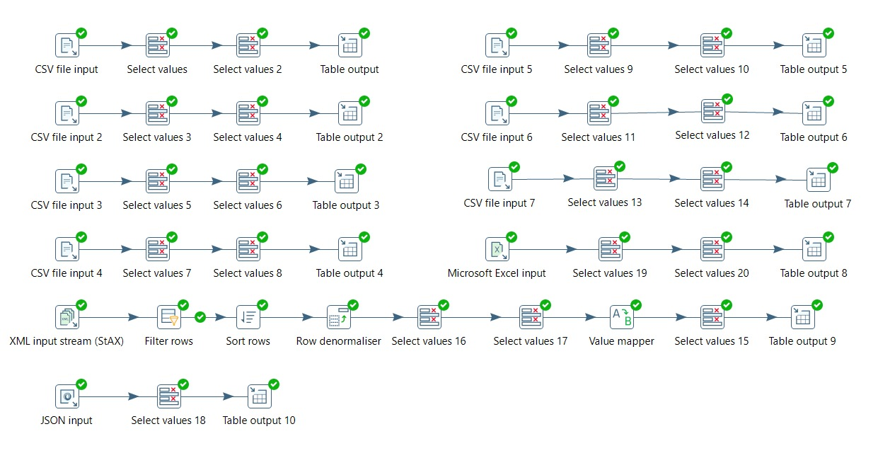
Sprint 1 :Pentaho ETL Pipelines

Slide 15
Sprint 2: Data Profiling & Data Warehouse
Objective : Transform the raw financial data in the PostgreSQL staging layer into trusted, analytics-ready datasets. This is done by profiling and quality-checking the ten SAP staging tables, then designing and building a star schema data warehouse
Key Activities
Profile the financial datasets using Python.
Identify duplicate financial transactions, missing accounting entries, inconsistent ledger balances and master data quality issues.
Clean and standardize the financial records.
Design the star schema.
Create the fact and dimension tables.
Build Pentaho transformations to populate the warehouse tables

Slide 16
Sprint 2: Process
Profile: Read-only checks on every table. These cover column types, row counts, NULLs and blanks, exact duplicate rows and numeric statistics.
Assess quality: Score each table on completeness, uniqueness, validity and consistency. Rate each failed rule Low (under 1% of rows affected), Medium (1 to 5%) or High (over 5%).
Clean and standardize: Apply agreed rules to a separate cleaned dataset. The staging tables are not changed.
Model: One fact table (fact_accounting_line_item) and its dimensions.
Load: load the dimensions first, then the fact table, and reconcile row counts.

Slide 17
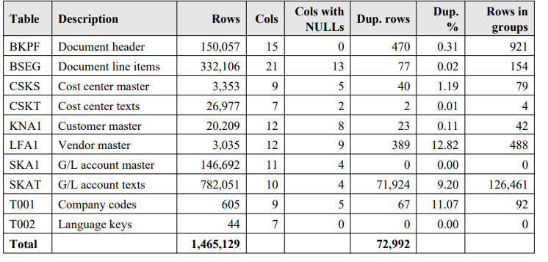
Sprint 2:Data Profiling

Slide 18
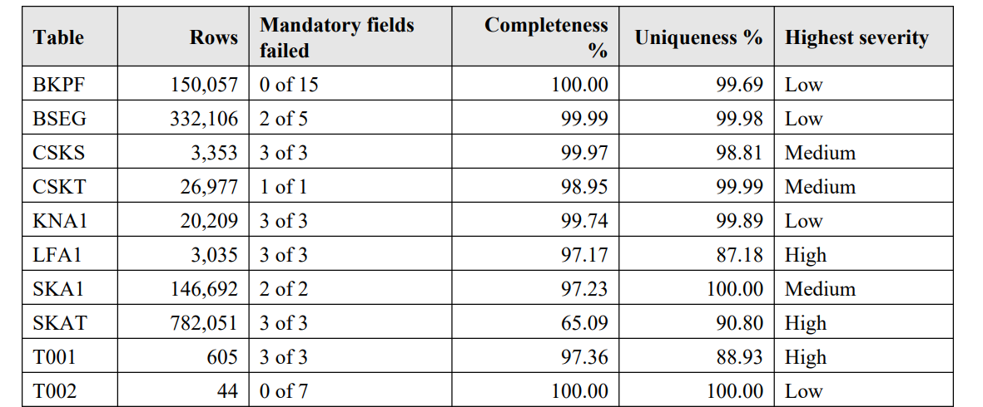
Sprint 2:Data Profiling

Slide 19
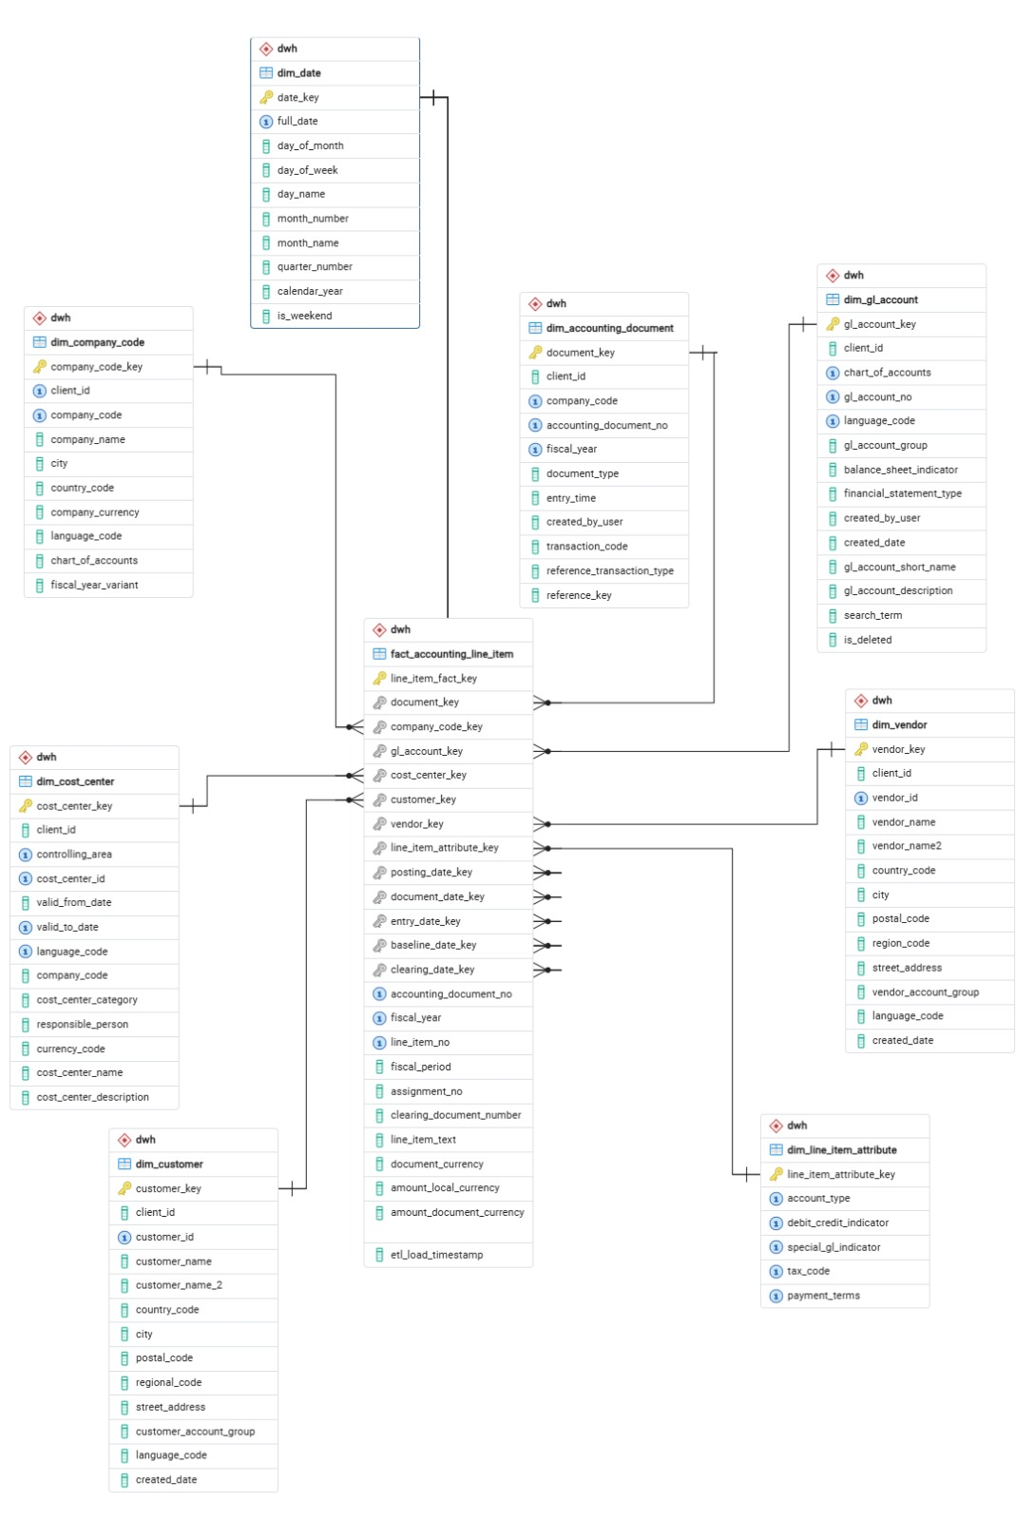
Sprint 2: Star Schema
Fact Table:
fact_accounting_line_item
Dimension Table :
dim_accounting_document
dim_company_code
dim_gl_account
dim cost center
dim_customer
dim vendor
dim_language
dim date

Slide 20
Sprint 2 : Deliverables
Sprint 2 deliverables
Data Profiling Report: Structure, completeness and duplication of the ten staging tables.
Data Quality Report: Rule-based scores and severity per table, priority issues and recommendations.
Star Schema: The fact and dimension model and the staging-to-warehouse name mapping.
PostgreSQL Data Warehouse: Fact and dimension tables populated by transfer the data form staging table.

Slide 21
Sprint 3: Visual Analytics & Governance
Objective : Turn the star-schema warehouse into business-ready reporting by building the EFDP Power BI dashboard on the PostgreSQL warehouse, and by documenting the governance and traceability controls of the platform.
Key Activities
Connect Power BI to the warehouse star schema.
Import the fact table and dimensions and define their relationships.
Build KPI cards, trend and breakdown visuals, and a company code slicer.
Review dashboard totals against the staging data.
Document governance and traceability controls.

Slide 22
Sprint 3: Process
Connect: Power BI reads the fact_accounting_line_item table and its dimensions from the PostgreSQL warehouse (schema dwh).
Model: Relationships follow the surrogate keys of the star schema, so one filter reaches every visual.
Visualize: KPI cards for line items, total debit, total credit and net debit balance; charts by year and quarter, G/L account and company code.
Filter: A company_code slicer (C001 to C005, EU01, USA1) re-cuts every visual at once.
Validate: Compare dashboard totals with staging counts and flag unusually large amounts for finance review.
Govern: Keep the data dictionary, source-to-warehouse mapping, quality findings and load controls together under Git.

Slide 23
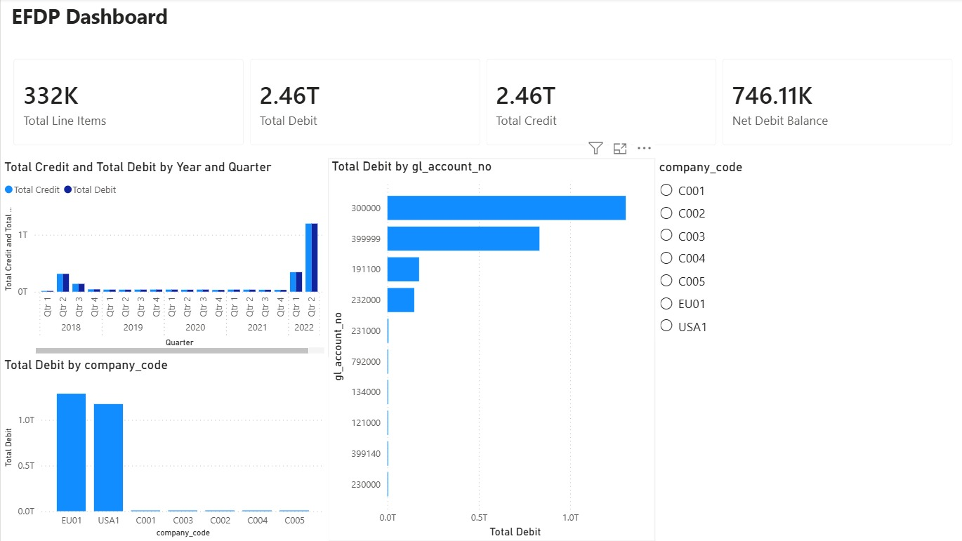
Sprint 3: EFDP Dashboard

Slide 24
Sprint 3: Dashboard Insights
Key figures: 332K line items, 2.46T total debit, 2.46T total credit and a net debit balance of 746.11K.
Balanced books: Debit and credit totals match, so the net balance is about 0.00003% of total debit.
Volume matches staging: 332K line items agrees with the 332,106 rows of stg_bseg.
Trend: Activity is small from 2018 to 2021 and peaks in 2022 Q2.
Concentration: EU01 and USA1 carry almost all debit; G/L accounts 300000 and 399999 are the largest.
Caution: Very large BSEG amounts (up to about 98.98 billion) drive the totals and need finance review.

Slide 25
Sprint 3 : Deliverables
Sprint 3 deliverables
EFDP Power BI Dashboard: KPIs and analysis by period, G/L account and company code on the star schema.
Star Schema Load Job: Pentaho transformations and one orchestration job that load the dimensions and then the fact table.
Governance Documentation: Data dictionary, source-to-warehouse mapping, quality findings and load controls.
Project Report: Sprint 0 to Sprint 3 report with screenshots.
Git Repository: Version-controlled ETL, SQL and documentation.

Slide 26

THANK
YOU!

